Slide 1
Unsymmetrical fault

Slide 2
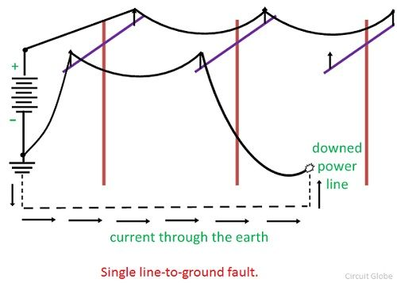
Single Line-to-Ground Fault
A single line-to-ground fault on a transmission line occurs when one conductor drops to the ground or comes in contact with the neutral conductor.

Slide 3
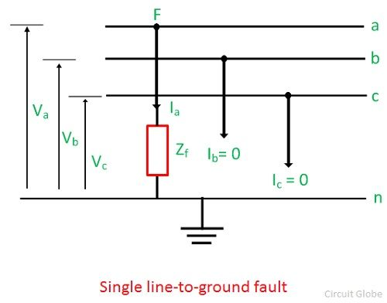
Circuit diagram of single line-to-ground fault
Most frequently occurring fault.
Usually assumed the fault on phase – a for analysis purpose. The phase a is connected to ground at the fault point F as shown in a figure below, phase – b and phase c are healthy. I_{a}, I_{b} and I_{c} are the current and V_{a}, V_{b} and V_{c} are the voltage across the three phase line a, b and c respectively. The fault impedance of the line is Z_{f}.
Since only phase a is connected to ground at the fault, phase b and c are open circuited and carries no current; So, fault current is I_{a}
Also, I_{b} = 0,
I_{c} = 0.
The voltage at the fault point F, V_{a} = Z_{f} I_{a}.

Slide 4
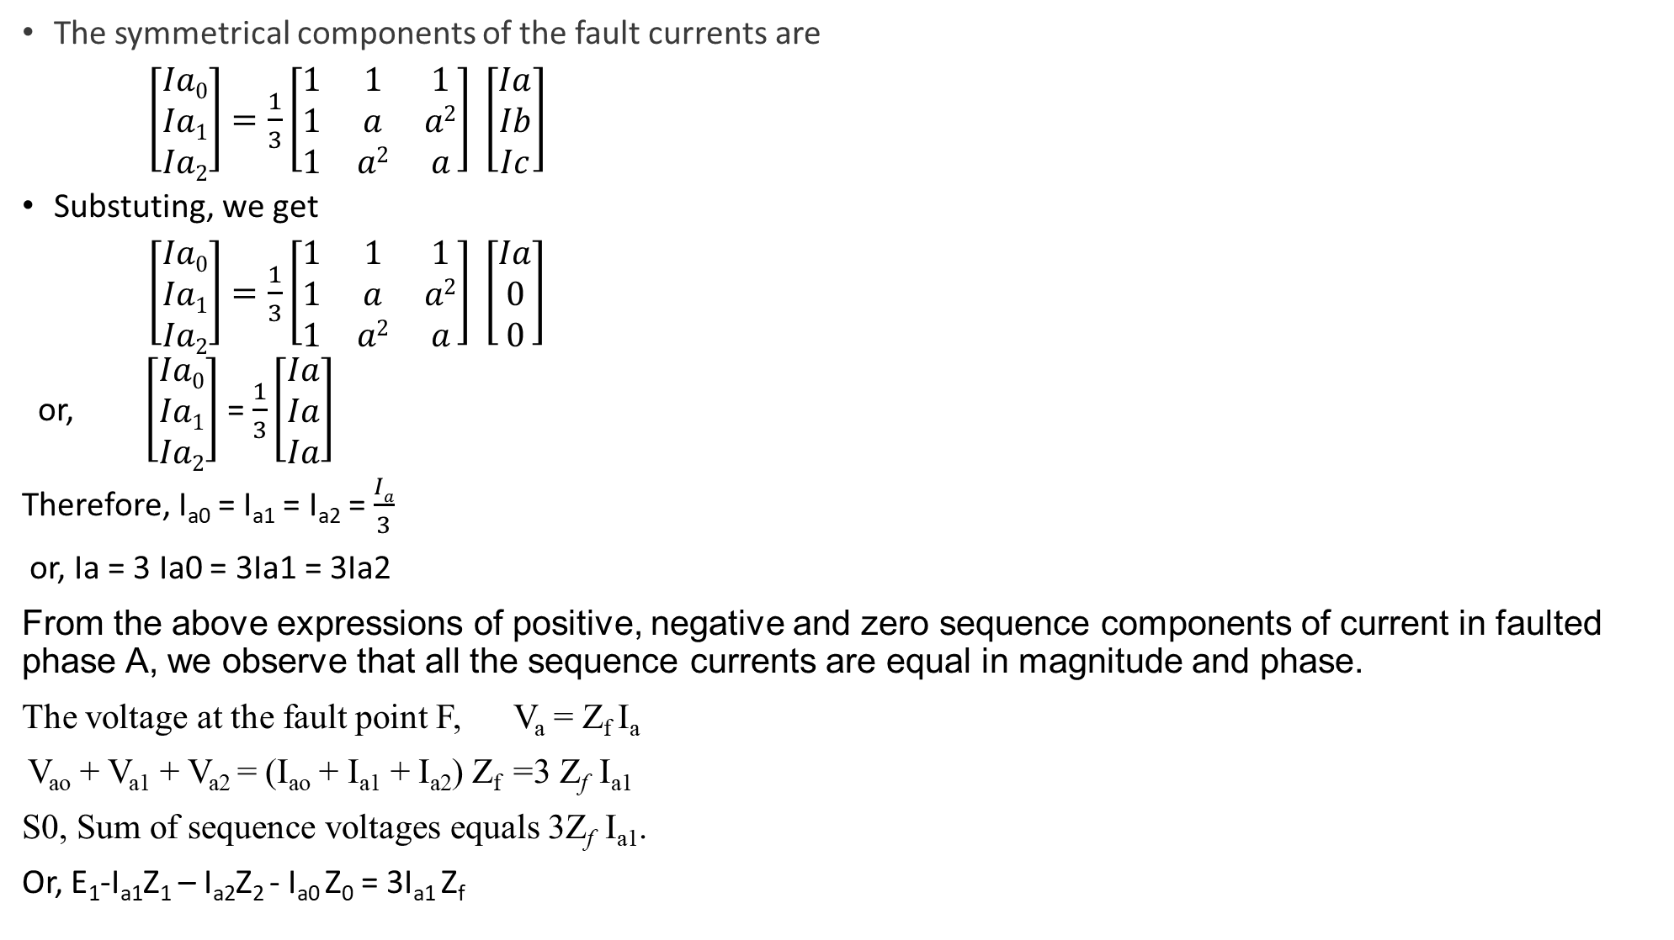
The symmetrical components of the fault currents are
$\left[\begin{matrix}Ia0 \\ Ia1 \\ Ia2\end{matrix}\right]=\frac{1}{3}\left[\begin{matrix}1 & 1 & 1 \\ 1 & a & a2 \\ 1 & a2 & a\end{matrix}\right] \left[\begin{matrix}Ia \\ Ib \\ Ic\end{matrix}\right]$
Substuting, we get
$\left[\begin{matrix}Ia0 \\ Ia1 \\ Ia2\end{matrix}\right]=\frac{1}{3}\left[\begin{matrix}1 & 1 & 1 \\ 1 & a & a2 \\ 1 & a2 & a\end{matrix}\right] \left[\begin{matrix}Ia \\ 0 \\ 0\end{matrix}\right]$
or, $\left[\begin{matrix}Ia0 \\ Ia1 \\ Ia2\end{matrix}\right]$ = $\frac{1}{3}\left[\begin{matrix}Ia \\ Ia \\ Ia\end{matrix}\right]$
Therefore, I_{a0} = I_{a1} = I_{a2} = $\frac{Ia}{3}$
or, Ia = 3 Ia0 = 3Ia1 = 3Ia2
From the above expressions of positive, negative and zero sequence components of current in faulted phase A, we observe that all the sequence currents are equal in magnitude and phase.
The voltage at the fault point F, V_{a} = Z_{f} I_{a}
V_{ao} + V_{a1} + V_{a2} = (I_{ao} + I_{a1} + I_{a2}) Z_{f} =3 Z_{f} I_{a1}
S0, Sum of sequence voltages equals 3Z_{f} I_{a1}.
Or, E₁-I_{a1}Z₁ – I_{a2}Z₂ - I_{a0} Z₀ = 3I_{a1} Z_{f}

Slide 5
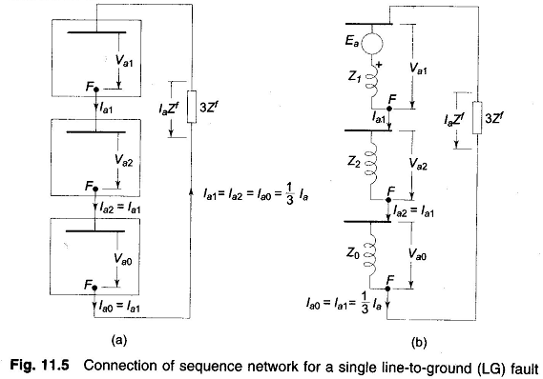

Or, E₁ - I_{a1} (Z₁ + Z₂ +Z₀ ) = 3I_{a1} Z_{f}
Therefore, I_{a1} = $\frac{\text{E}\text{1}}{\text{(}\text{Z}\text{1 }\text{+ }\text{Z}\text{2}\text{ +}\text{Z}\text{0}+ 3 Zf )}=\text{I}\text{a}$₂ = I_{a0}
Hence, +ve, −ve and zero sequence networks are connected in series.
And, I_{f} = I_{a} = (I_{a1} + I_{a2} + I_{a0}) = 3 $\text{I}\text{a}$₁ = $\frac{3 \text{E}\text{1}}{\text{(}\text{Z}\text{1 }\text{+ }\text{Z}\text{2}\text{ +}\text{Z}\text{0}+ 3 Zf )}$

